Slide 1
Galaxy Zoo Morphology Classifications by CNN
Colin Leach

Slide 2
Why?
Rapid growth in survey data, static number of astronomers
Citizen Science helped fill the gap over the last 20 years
Sufficient for SDSS, will struggle with DES, Rubin, etc
Need to use machines for a first-pass analysis
Save humans for analyzing the difficult cases
Make machine learning more efficient
Galaxy Zoo has already classified >300k galaxy images
This work created pre-trained CNN models for these
A better starting point than ImageNet for new surveys!
Hope to train a new survey on far fewer human classifications

Slide 3
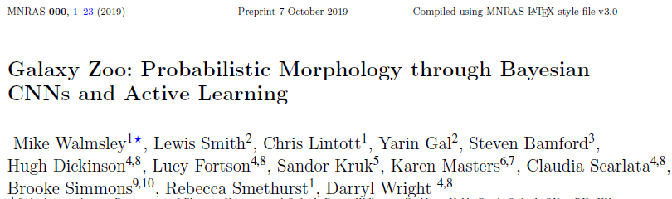
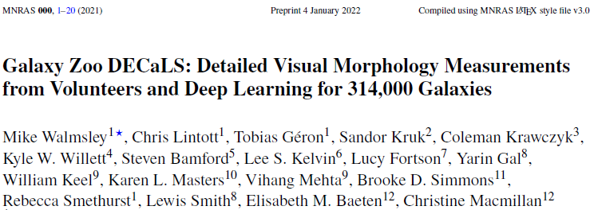
Papers
MNRAS 491, 1554 (2020)
(W+20)
MNRAS 509, 3966 (2021)
(W+21)
Better methods, better code, much better documentation
Notes:
Mainly done at Oxford. Work from Mike Walmsley doctorate; now postdoc at Manchester and GZ Technical Lead. Chris Lintott is founding PI of Galaxy Zoo, Yarin Gal is ML specialist in Computer Science dept. With 414k subscribers on YouTube, postdoc Becky Smethurst gets more publicity.

Slide 4
Links
Papers
https://ui.adsabs.harvard.edu/abs/2020MNRAS.491.1554W/abstract (W+20)
https://ui.adsabs.harvard.edu/abs/2022MNRAS.509.3966W/abstract (W+21)
Mike Walmsley repos
For W+20: https://github.com/mwalmsley/galaxy-zoo-bayesian-cnn (static)
For W+21: https://github.com/mwalmsley/zoobot (active development)
My repo
https://github.com/colinleach/proj502

Slide 5
Objectives (original)
Get the published code running on my local machine, using whatever cut-down training set proves viable.
Deploy the code on either AWS or Google.
Extend the model to other data such as Hubble, CANDELS, DECaLS, for which there is already some GZ classification.
Think about newer CNN algorithms (W+20 used VGG16)
Rewrite using other frameworks, for my education:
PyTorch
Julia with Flux
(F# with ML.NET, but don't hold your breath waiting for that!)
Notes:
Plans don’t always survive contact with reality

Slide 6
Objectives (modified)
Get the published code running on my local machine, using whatever cut-down training set proves viable.
Deploy the code on either AWS or Google.
Use GZ2 and DECaLS data initially, perhaps others later
Think about newer CNN algorithms Stick with EfficientNet B0
Repeat with PyTorch (code from branch of mwalmsley/zoobot)
Later, rewrite using other frameworks, for my education:
Julia with Flux
(F# with ML.NET, but don't hold your breath waiting for that!)

Slide 7
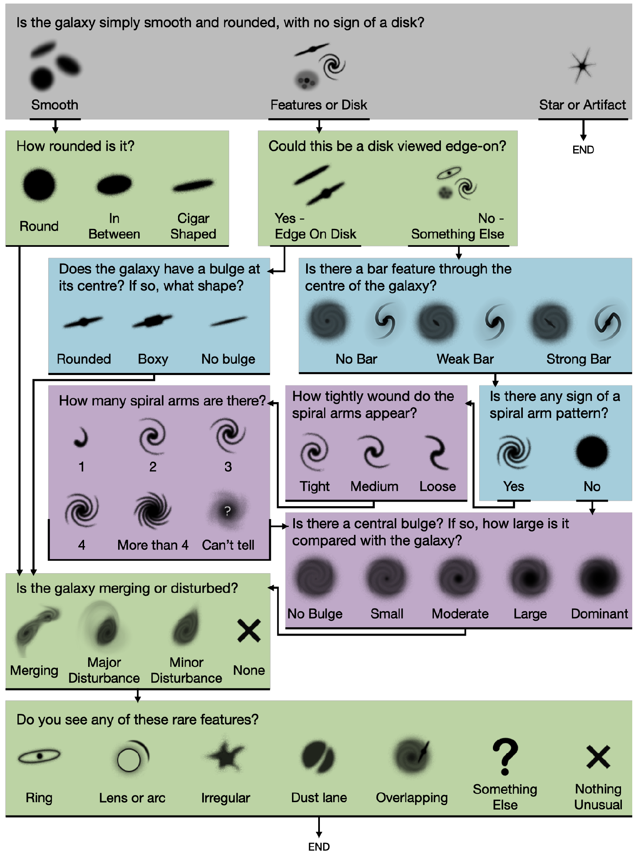
Galaxy Morphology Classification
decals_pairs = {
'smooth-or-featured': ['smooth', 'featured-or-disk', 'artifact'],
'disk-edge-on': ['yes', 'no'],
'has-spiral-arms': ['yes', 'no'],
'bar': ['strong', 'weak', 'no'],
'bulge-size': ['dominant', 'large', 'moderate', 'small', 'none'],
'how-rounded': ['round', 'in-between', 'cigar-shaped'],
'edge-on-bulge': ['boxy', 'none', 'rounded'],
'spiral-winding': ['tight', 'medium', 'loose'],
'spiral-arm-count': ['1', '2', '3', '4', 'more-than-4', 'cant-tell'],
'merging': ['none', 'minor-disturbance', 'major-disturbance', 'merger']
}
10 Questions
34 possible answers
Model is trying to predict probability of getting each answer (Bayesian posterior)
Output is a 34-element array of numbers between 0 - 1

Slide 8
Hardware and Runtime Environments
Any 2GB GPU (GTX 1050, MX 230)
Immediate out-of-memory error (for virtually anything)
6GB GTX 1660
$450 purchase, old design but compatible with my Linux PC
Good for debugging
Limited capability for training
Colab Pro+ with 16GB Tesla V100
Can train at recommended batch size (just, barely)
AWS EC2? Colab TPU?
Will try these later

Slide 9
Galaxy Images and Catalogues
DECaLS : Everything is easily available on Zenodo
https://zenodo.org/record/4573248
GZ2 : Catalog is online
https://data.galaxyzoo.org
GZ2 images are not made public, need to get them from SDSS
This isn’t the end of the story…
sdss_url = http://skyserver.sdss.org/dr14/SkyServerWS/ImgCutout/getjpeg
img_url = sdss_url + f"?ra={ra:.5f}&dec={dec:.5f}&width={jpeg_size}&height={jpeg_size}
img_data = requests.get(img_url).content
Notes:
Most data scientists spend most of their time data-munging.

Slide 10
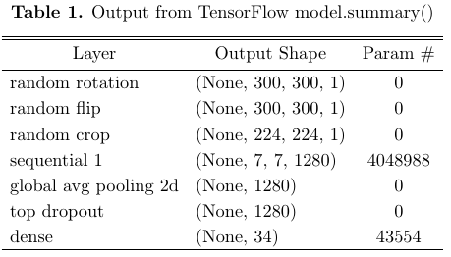
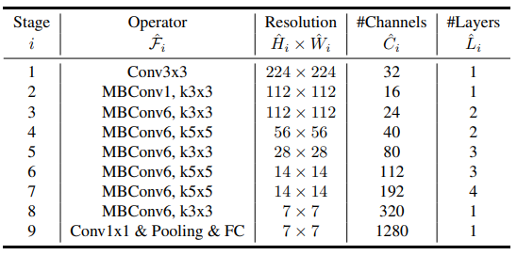

CNN Model
W+20 used a cut-down VGG16 (cheaper to run)
W+21 and this work use EfficientNet-B0
The PyTorch branch recently added a ResNet50 option (less good, more familiar)
EfficientNet-B0
Custom Loss function:
https://arxiv.org/abs/1905.11946v5
Adam optimizer
No good accuracy function available
Notes:
Understanding the statistical basis is left as an exercise for the audience.

Slide 11
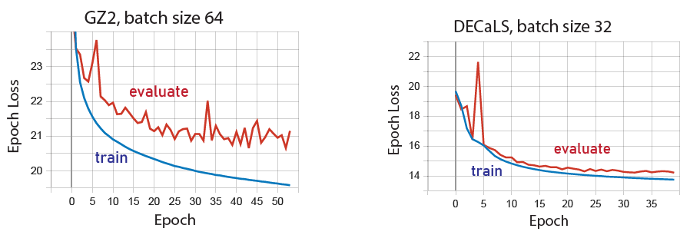
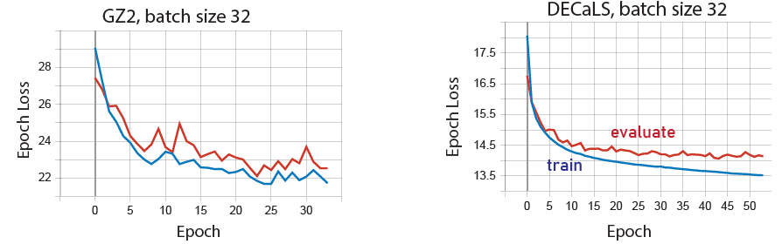
Training with Keras/TensorFlow (local)
Started with batch size 128, kept halving until training ran without OOM errors
Worked consistently better with DECaLS than GZ2
Matching batch size only makes GZ2 worse
Time to take another look at image quality?

Slide 12
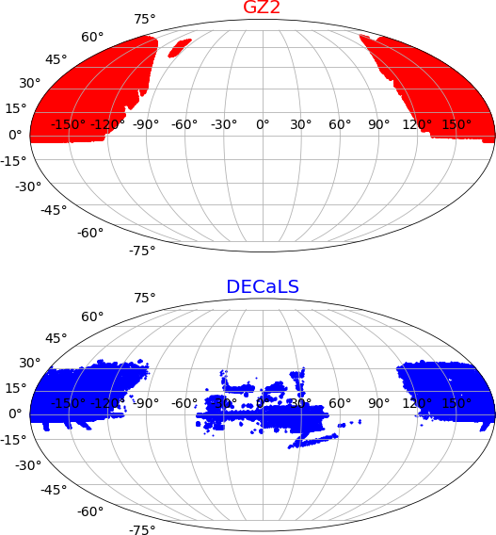
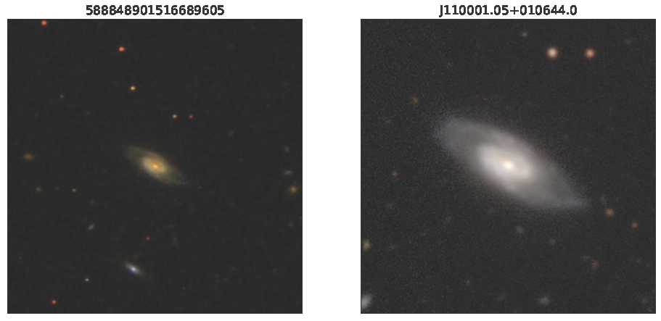
Images, the Sequel
Why is GZ2 training so poor compared with DECaLS?
Different training methods (batch size, image size)?
Different image quality?
Need examples of the same galaxy in both surveys
No common ID field
Matched on RA and Dec values (in PostgreSQL)
Found 132,732 matches
Biggest difference is scaling (ignore color)
After reading the documentation (!!), a new set of SDSS images were downloaded with 4x zoom-in
0.1 vs default 0.4 arcsec/pixel
Garbage in, Garbage out – a very old idea

Slide 13
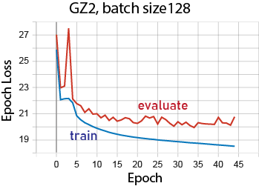
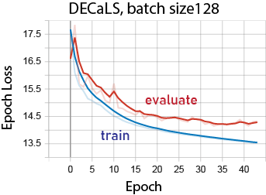
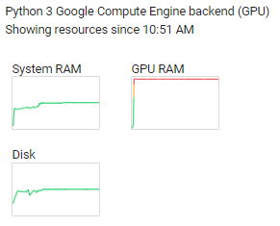
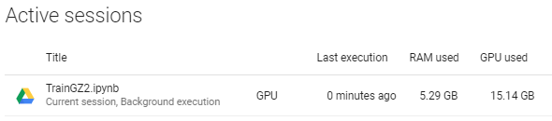
Training on Colab
All files stored on Drive
Training takes >12h on a V100, so eventually upgraded to Colab Pro+ ($50/month)
Even a 16GB GPU nearly ran out of memory
Results are a bit better than on my home PC
not as much as hoped for

Slide 14
Predictions
ToDo

Slide 15
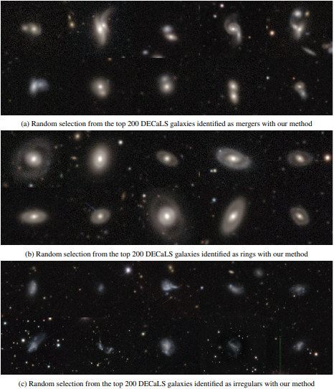
Transfer Learning and Fine-Tuning
Extend the model to new tasks
Other surveys (e.g. Rubin, Euclid)
Other features: rings, dust lanes, etc
Start from published weights
Freeze most of the model layers
Train the last few layers on limited new data, order 10² not 10⁵
https://arxiv.org/abs/2110.12735

Slide 16
Still To Do…

Slide 17
Summary

